Slide 1
Biology: Life Processes
Year 7 Science

Slide 2
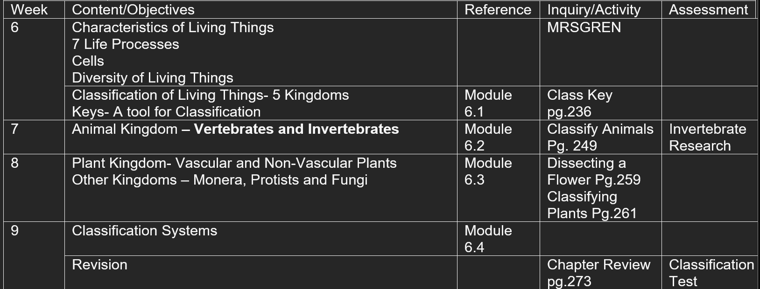
Preview
There are differences within and between groups of organisms; classification helps organise this diversity.

Slide 3
Learning Intentions
All living things undergo essential life processes.

Slide 4
Success criteria
List processes that all living things undergo (MRS GREN)

Slide 5
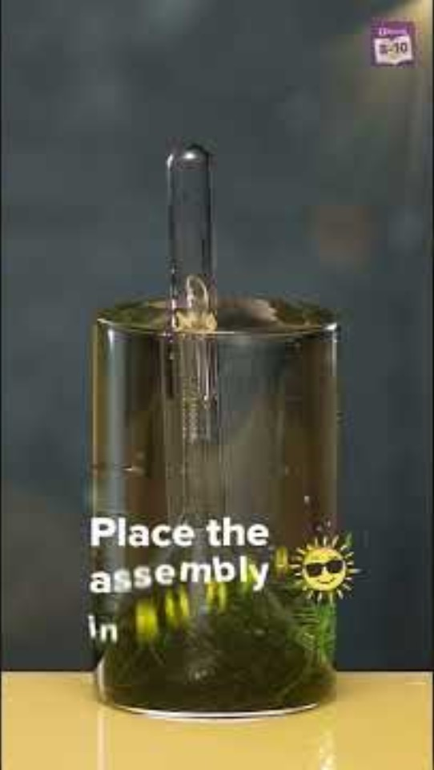
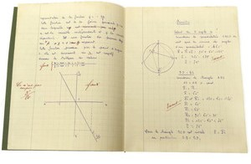
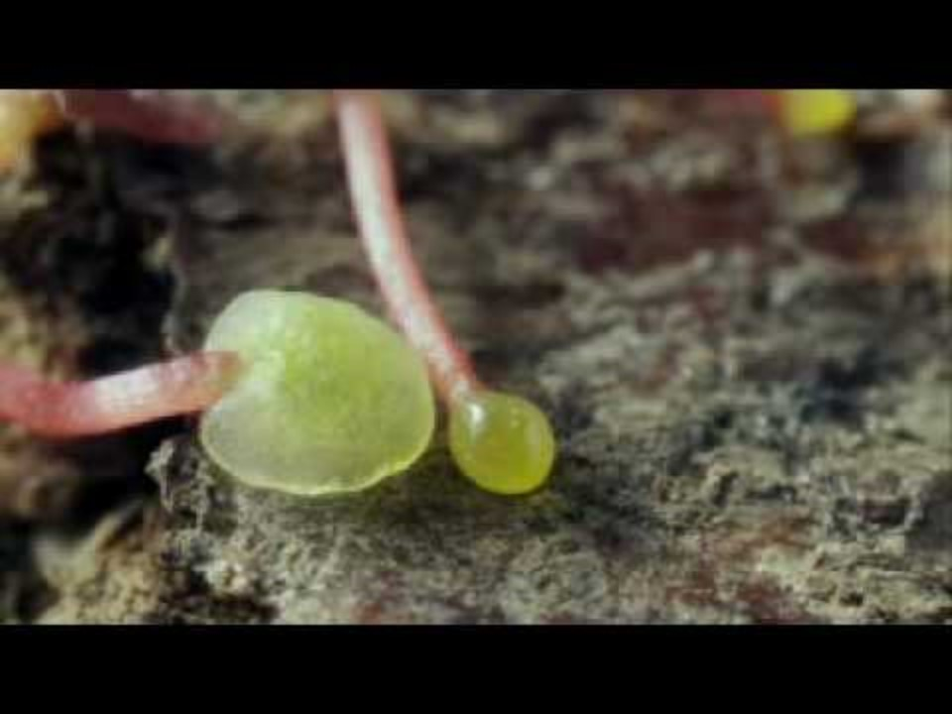
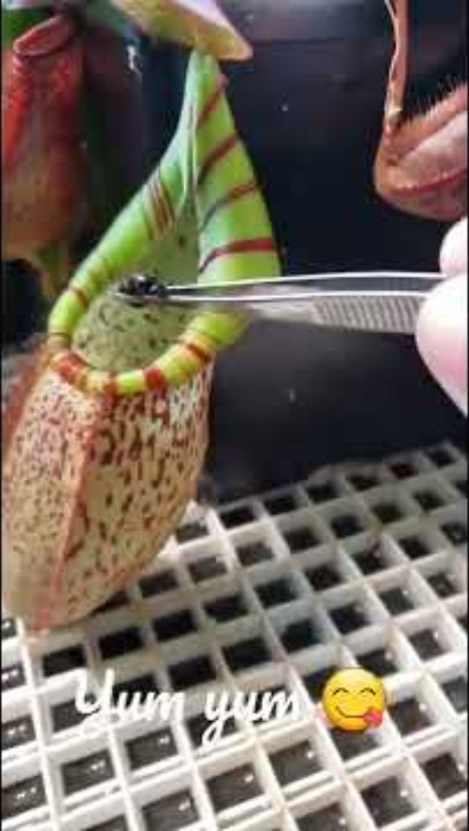
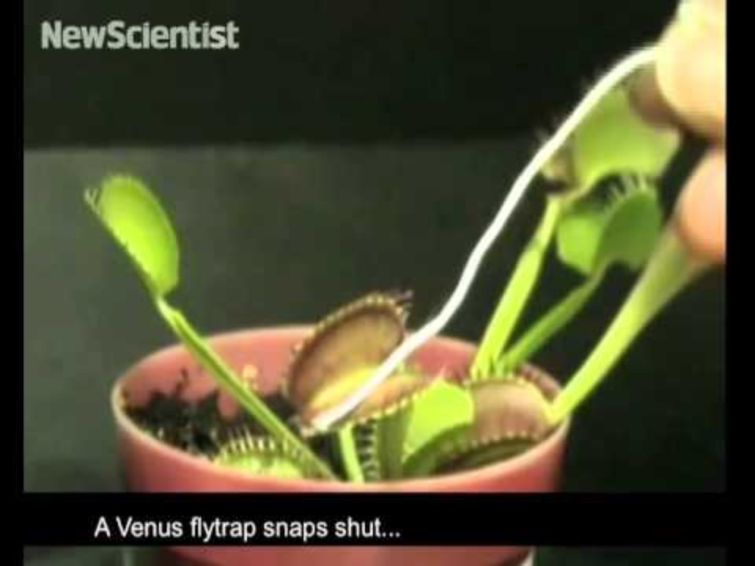
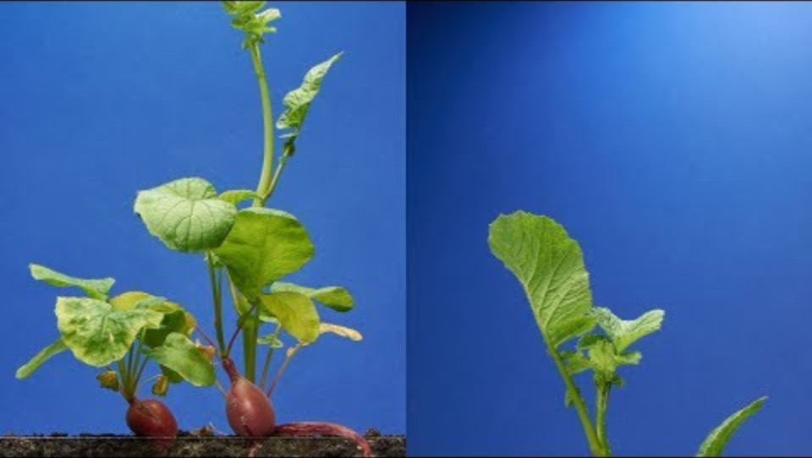
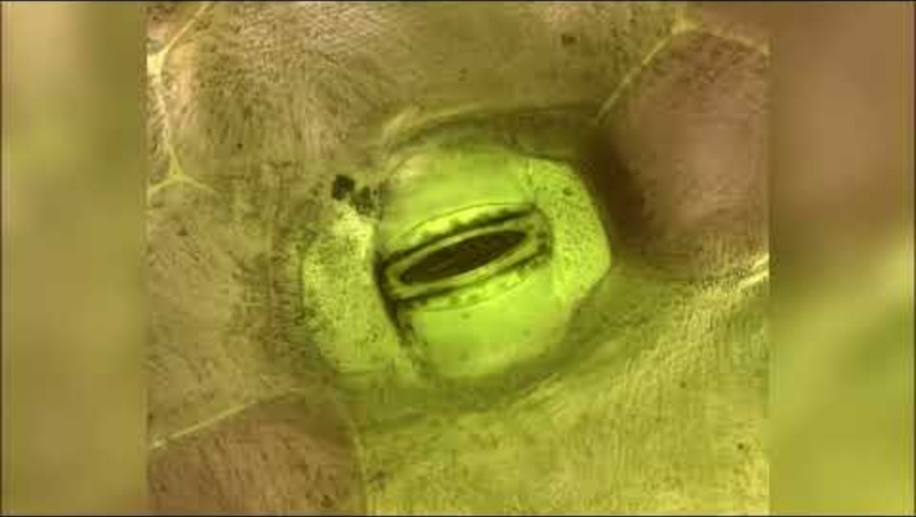
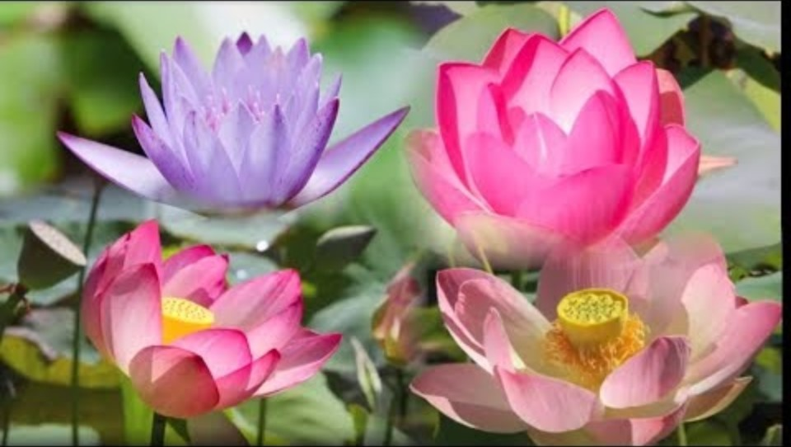
Living things are called organisms
All living things, including cells, undergo essential life processes:
M
R
S
G
R
E
N
ovement
espiration
ensitivity
rowth
eproduction
xcretion
utrition

Slide 6

Using MRS GREN
Is fire alive?
So living things must MRS GREN and contain cells.

Slide 7
Success criteria
List processes that all living things undergo (MRS GREN)

